Slide 1
CAB FARE PREDICTION
Project By : Vikas S Dudhe

Slide 2
Introduction
For a cab rental start-up company, the fare quantity relies on a great deal of things.
This analysis aims to know all patterns and to use analytics for fare prediction.
The aim is to make regression models, which can predict the continual fare quantity for every cab ride and facilitate prediction counting on multiple time-based, point and general factors.

Slide 3
Overview of Data
• fare_amount - float value indicating the fare amount for the ride.
• pickup_datetime - timestamp value indicating when the cab ride started.
• pickup_longitude - float for longitude coordinate of where the cab ride started.
• pickup_latitude - float for latitude coordinate of where the cab ride started.
• dropoff_longitude - float for longitude coordinate of where the cab ride ended.
• dropoff_latitude - float for latitude coordinate of where the cab ride ended.
• passenger_count - an integer indicating the number of passengers in the cab ride.

Slide 4
Problem Statement
You have collected the historical data from your pilot project and now have a requirement to apply analytics for fare prediction.
You need to design a system that predicts the fare amount for a cab ride in the city.

Slide 5
Methodology
Exploratory Data Analysis
Missing Value Analysis
Outlier Analysis
Feature Selection
Feature Engineering
Feature Scaling
Data Visualization

Slide 6
Modeling
Model Selection
Linear Regression
Random Forest
XGBoost

Slide 7
Model Evaluation
Root Mean Squared Error (RMSE)
Mean Absolute Error (MAE/ MAPE)
R_squared

Slide 8
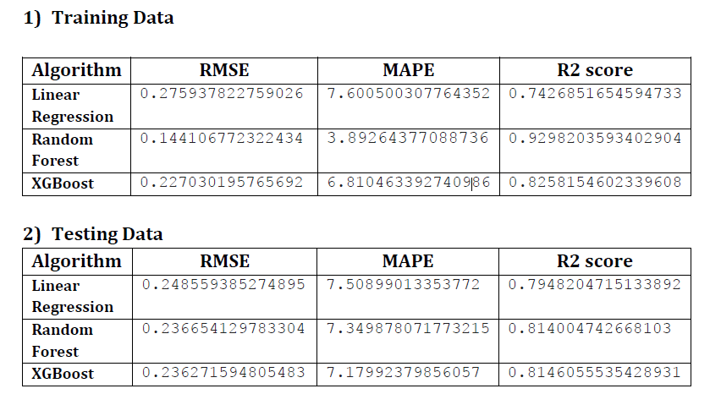
Model Evaluation Summary

Slide 9
Model Acceptance
R-squared is a goodness-of-fit measure for linear regression models.
R-squared measures the strength of the relationship between your model and the dependent variable on a convenient 0 – 100% scale.
From above summary we can see the maximum r2 score given by Random Forest algorithm with tuning parameters in both train and test data.
Hence, we are going to finalize the Random Forest Algorithm for prediction of cab price.

Slide 10
Thank You

